Slide 1

DS102 & DS104 Final Project Presentation
Presented by: Daniel Tan

Slide 2
Contents
Recap
Description
Main Goal: Which company, job title and country should I aim to work for between 2017 - 2021?
Company
Job Title
Each year of industrial experience affect base salary
Location and Base salary over time
Avg base salary across companies that are situated in at least 10 countries

Slide 3


Dataset description
Individual level salary records from international companies.
Time period: Jun 2017 - Aug 2021
Content
62, 642 rows by 29 columns
Data Size

Slide 4
key data columns
Column Header | Description
Time Stamp | Time data was individual’s salary was recorded e.g. 7 Jun 2017 at 11:33:27
Company | Company name e.g. Oracle, eBay, Amazon, etc.
Job title | Job title given to individual e.g. Software Engineer, Product Manager, HR, Sales, etc.
Years of experience | Years of experience working as their job title (up to 1 decimal place) e.g. 1.5, 14.0
Years at company | Years working at said company (up to 1 decimal place) e.g. 1.3, 3.0, 4.0
Base salary | Annual salary received when they first joined the company e.g. 155 000, 107 000
Tag | Job responsibilities e.g. ML/AI, iOS, Full Stack, Solution management, etc.
Location | State, Country e.g. New Delhi, India; Amsterdam, Netherlands; Berlin, Germany

Slide 5
Main Goal: Which company, job title and country should I aim to work for between 2017 - 2021?
Best Paying Company
(Deeper dive)
Best Paying Job Title
(Deeper dive)
How much does each year of industrial experience add to our base salary?
Insights between Location and Base salary over time
Avg base salary across companies that are situated in at least 10 countries

Slide 6
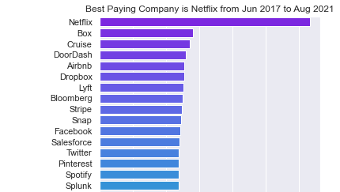

Best Paying Company*
Netflix – SGD 632k per annum
Possible Reasons:
Time period was when Netflix subscriptions was booming
In 2020, people were under Covid lockdowns and had nothing better to do at home
…………
*Note:
Base salaries were averaged and not standardised by years of experience

Slide 7
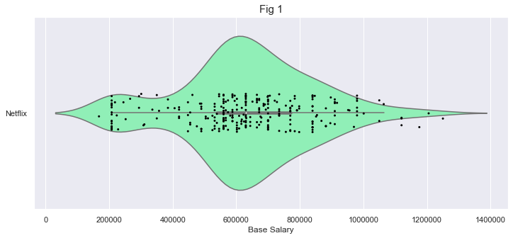
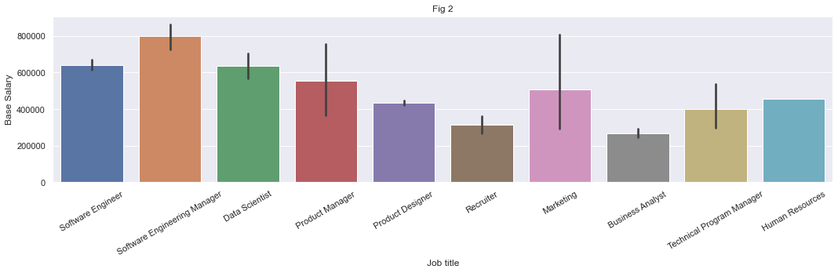
deeper dive into netflix
Basic describe() → Fig 1
Average = 632k per annum
Minimum = 168k per annum
Maximum = 1.25mil per annum
Median = 630k per annum
The crazy rich 1.25mil employee was a Senior Software Engineer with 19 years of industry experience and 8 years working in Netflix (CA, USA)
BUT
Mean comparison by job title, the best title is Software Engineering Manager (Fig 2)

Slide 8
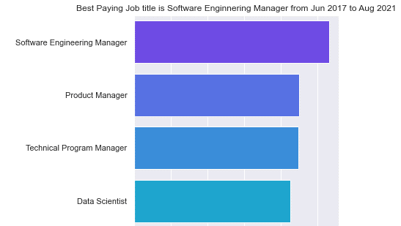
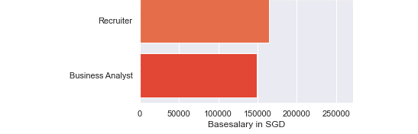
Top 3 Best Paying Job titles*
Software Engineering Manager – SGD 266k per annum
Possible reason: During Covid, digitalisaiton was picking up hence more remote software based solutions were needed
Product Manager - SGD 226k per annum
Technical Program Manager - 224k per annum*Note:
…………
*Note:
Not segregated by companies nor years of experience

Slide 9
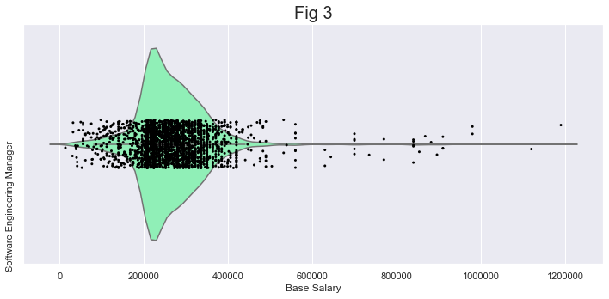
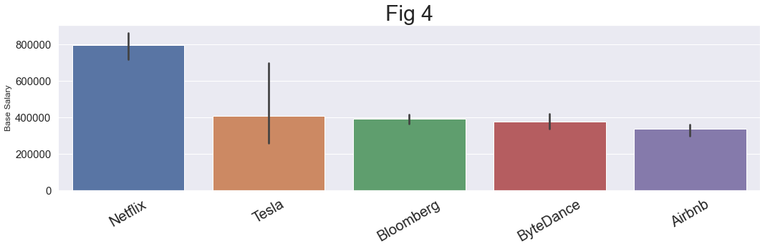
Deeper dive into job title of software engineering manager
Basic describe() → Fig 3
Average = 266k per annum
Minimum = 14k per annum
Maximum = 1.19mil per annum
Median = 252k per annum
The crazy rich 1.19mil Software Engineering Manager worked at Microsoft (WA, USA) for 8 years with 24 years of industry experience
BUT
This employee is an exception because Netflix still outranks Microsoft in on an average Senior Engineering Manager job title

Slide 10
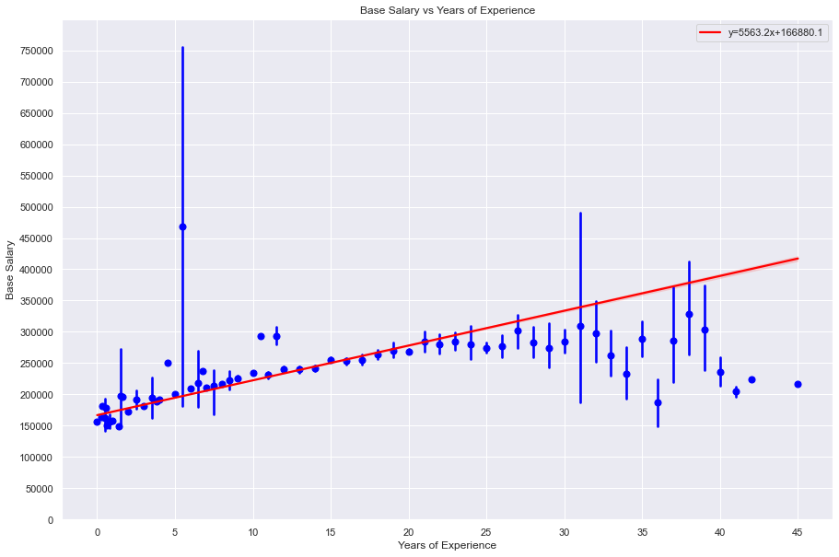
Scatterplot & Linear Regression for Salary vs Years of Exp*
On average, based on each year of experience should give you SGD 5600 per annum with a base pay of 167000 per annum
*Note:
1. This is regardless of company and job title

Slide 11
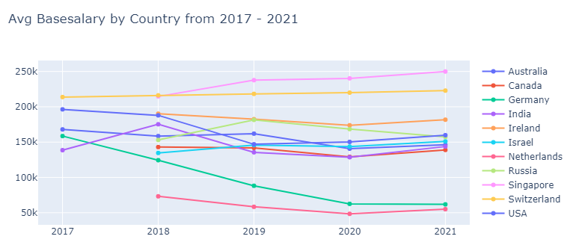
Insights between Location and Base salary and time*
Overall, best country to be employed since 2019: Singapore
2021’s average basesalary (regardless of company) being 250k per annum
In 2018, Switzerland (217k per annum) beat Singapore’s (215k per annum) avg base salary to be no.1
Eyeballing the linear trend, Germany’s base salary has been dropping drastically
This could be contributed by the weakening EUR since 2018 (1 EUR : 1.6 SGD) to 2021 (1 EUR: 1.4 SGD
*Note:
Base salaries are averaged regardless of
Company, job title and years of experience

Slide 12
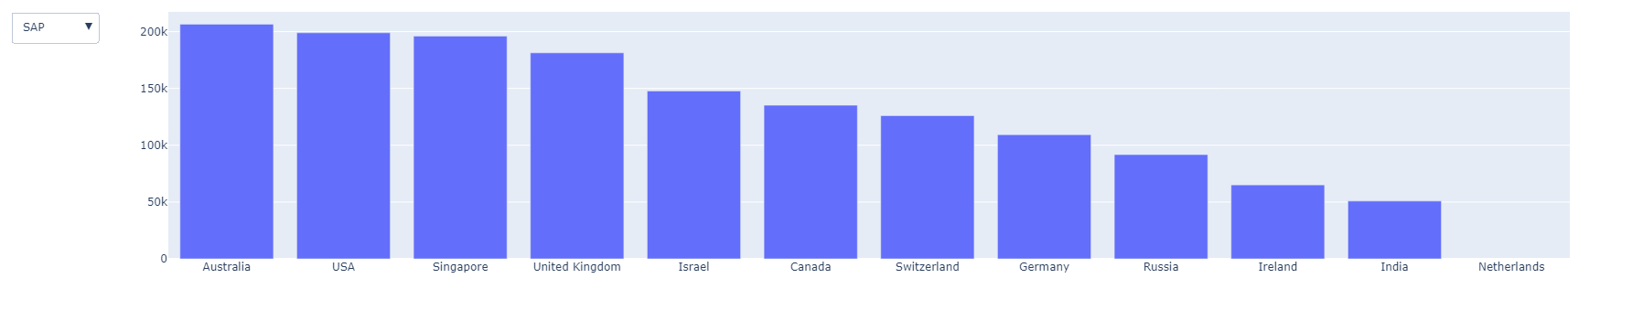
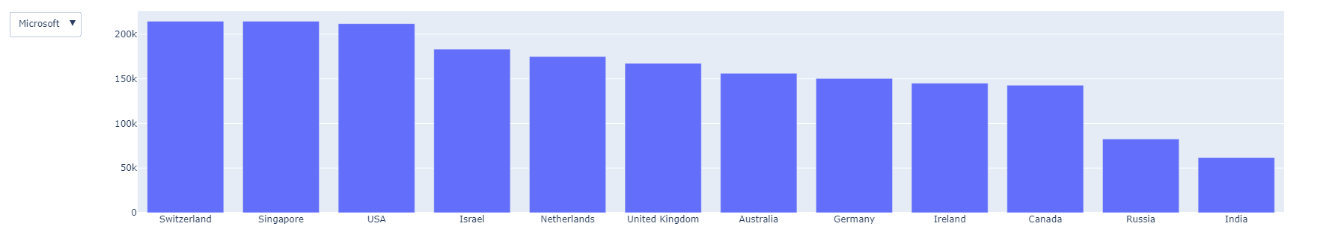
Average base salary across companies that are situated in at least 10 countries (SAP & Microsoft)

Slide 13
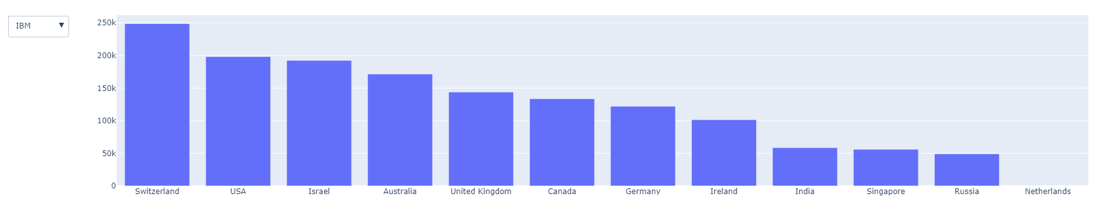
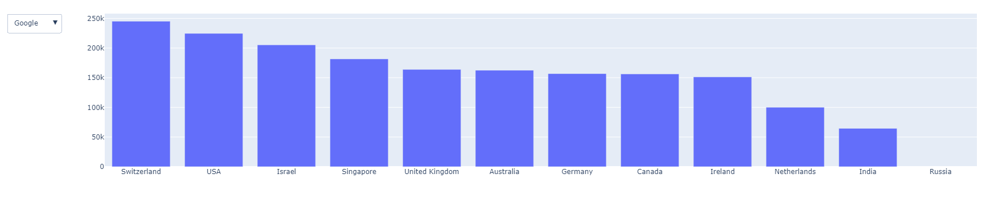
Average base salary across companies that are situated in at least 10 countries (IBM & Google)

Slide 14
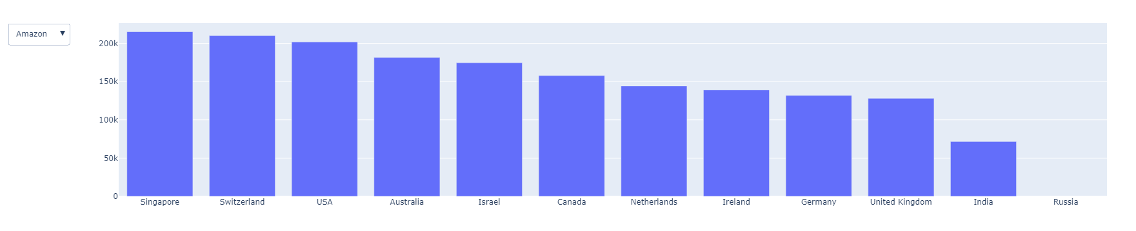
Average base salary across companies that are situated in at least 10 countries (amazon)

Slide 15




Conclusion (To earn the most from 2017 - 2021)
Aim for Software Engineering Manager and if so, aim for Netflix
Job title & Company
Years of experience matter, and
At the 5th year mark, salary raise can fluctuate from very little to a lot
Years of industry experience
No best country work in, but
My recommendation = Singapore or Switzerland (based on overall base salary over time)
Country

Slide 16
Thank you (Feedback)

